Slide 1

Presentation of Whitepaper on Integrating Energy Resilience into Hazard Mitigation Planning
North Central Texas Council of Governments
August 3, 2022

Slide 2
Welcome & Housekeeping
Please keep your line on mute until the end of the presentations.
We will have an open Q&A session at the end of all the presentations. Please type your question in the chat box or type in your request to speak.
The webinar slides and recording will be posted on the Conserve North Texas website under News/Events → Event Archive at the link below. Follow-up emails to come. http://conservenorthtexas.org/event-archive
Notes:
We are going to get started by covering some housekeeping items….(read slide)
In addition to today’s webinar presentations and recording, in the Event Archive on Conserve North Texas you will find other past events on the topic of energy efficiency and energy resilience. We would recommend checking out some of these out by searching for the keyword “Energy” in the search bar.

Slide 3
Agenda
  Welcome and Housekeeping
  Q&A
Notes:
We have a very full agenda today with guest speakers from FEMA, the State Energy Conservation Office, the Houston Advanced Research Center and the National Renewable Energy Laboratory.

Slide 4
Energy Resilience as Emergency Preparedness Strategy

Slide 5
Background
NCTCOG has received funding through the State Energy Conservation Office (SECO) to work on energy management and efficiency projects within the region. As part of our scope of work, we’re working on ways to incorporate energy efficiency and grid resiliency planning into hazard mitigation plans.
Winter storm Uri and the current summer heat waves are great reminders of the need to have different options available for energy resiliency.
Our Goal: Develop suggested language to go into the hazard mitigation plans and action tables and provide a menu of things that are achievable - ranging from what can be done with a more extensive budget and time to what can be done on a more limited budget and shorter timeline.

Slide 6
Why is Energy Resilience Important to Emergency Preparedness?
-Reduce Risk of Power Outages to Critical Infrastructure (e.g. medical facilities, airports)
-Reduce Demand for Emergency Responders to Residents in Need
-Reduce Risk of Exposure for Staff and Other Assets
Example projects could include:
  Adopting the latest and greatest codes (2016 or later)
  Combined Heat and Power (CHP) projects
  Alternative fuels in transportation and/or backup generation
  Microgrids capable of islanding from the larger grid to support critical infrastructure

Slide 7
Energy Resiliency and Emergency Management
Building
Codes
Energy Efficiency
Grid and Energy Resilience
Renewables
Microgrids & CHP
Transportation Strategies
Notes:
Transportation Strategies: adopting and using a variety of alternative fuels vehicles within your fleet. For example, during Winter Storm Uri TxDOT used their natural gas trucks while diesel pumps were not in service
Microgrids: Microgrids can be powered by distributed generators, batteries, and/or renewable resources such as solar panels. A switch can separate the microgrid from the actual grid to function as an island. Microgrids are also a great strategy to address FEMA hazards. In 2022, we will be hosting a Microgrid tour in our North Texas region so be on the lookout for more information on that as well as a presentation that goes into more detail on microgrids.
Renewables: coupled with storage can provide backup power if the grid goes down /when needed
Energy Efficiency: Efficiency allows for more critical services to be delivered with limited generation capacity and provides cost savings
Building Codes: the adoption and enforcement of building codes ensure sound construction and help build a culture of preparedness. Constructing to the latest model codes protects building occupants and the nation’s infrastructure investments

Slide 8
Examples of Microgrid Projects
Bronzeville, IL Microgrid Project
Project:
    Reduces system outages from natural hazards
    Improves overall system performance, reliability, and resilience for customers within the service area, and potentially neighboring customer areas
    Improves energy security, resilience to future conditions, and sustainability.
    Provides grid modernization and “smart city” technologies to improve community livability.
Addressed (FEMA) Hazards:
    All hazards (Primary)
    Inland flooding
    Winter storms
Blue Lake Rancheria Tribe Microgrid
Project:
    Targets a low-income community facing impacts from future conditions
    Less frequent physical damage to system components, less frequent system outages from natural hazards, and better overall system performance and resiliency
    Lowers costs for meter readings and usage monitoring
    Provides social benefits associated with reliable electric power
    Allows for better business continuity following major disasters that would otherwise typically have caused outages for days/weeks
Addressed (FEMA) Hazards:
    All hazards (Primary)
    Inland flooding
    Wildfires
Technology:
Solar, battery storage, control systems to island from main grid, ability to cluster with another nearby microgrid
Technology:
Solar, battery storage, control systems to island from main grid
Notes:
Addressed hazards may be different depending on location. Bronzeville, IL more likely to suffer from inland flooding and Blue Lake Rancheria Tribe (northern CA) more likely to suffer from Wildfires. Microgrids in Texas may address hazards of tornados, winter storms, hurricanes, inland flooding, drought and wildfires.

Slide 9
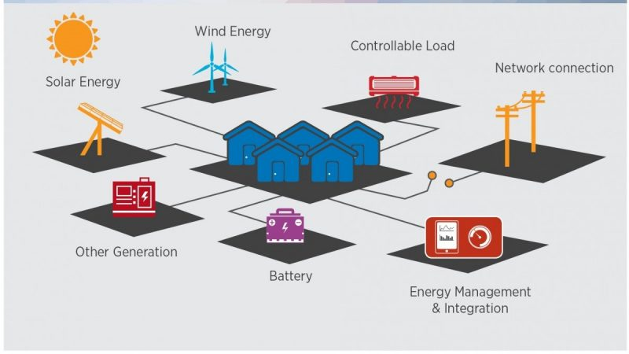
Microgrids
How do Microgrids work?
  Microgrids connects to the grid at a point of common coupling that maintains voltage at the same level as the main grid unless there is some sort of problem on the grid or other reason to disconnect. A switch can separate the microgrid from the main grid automatically or manually, and it then functions as an island.
  Microgrids can be powered by distributed generators, batteries, and/or renewable resources such as solar panels. Depending on how they are fueled, and their requirements are managed, microgrids might have the ability to run indefinitely.
(Image source: Iamrenew.com)

Slide 10
Poll Questions
To participate in poll questions:
Go to PollEv.com
Enter NCTCOGENV444
Notes:
We will have several poll questions throughout the presentation today. To participate, go to PollEv.com and then enter NCTCOGENV444.

Slide 11

Combined heat and power in texas
Roundtable on Integrating Energy Resilience into Hazard Mitigation Planning
October 2021

Slide 12

Statutory Requirements
Technical Assistance and Training
Clean Energy Incubation
LoanSTAR Loan Program
Watt Watchers of Texas
Energy Codes
Notes:
The Texas State Energy Conservation Office (SECO) works with Texas public schools and universities, local and county governments and state agencies to reduce energy costs and maximize efficiency.

Slide 13
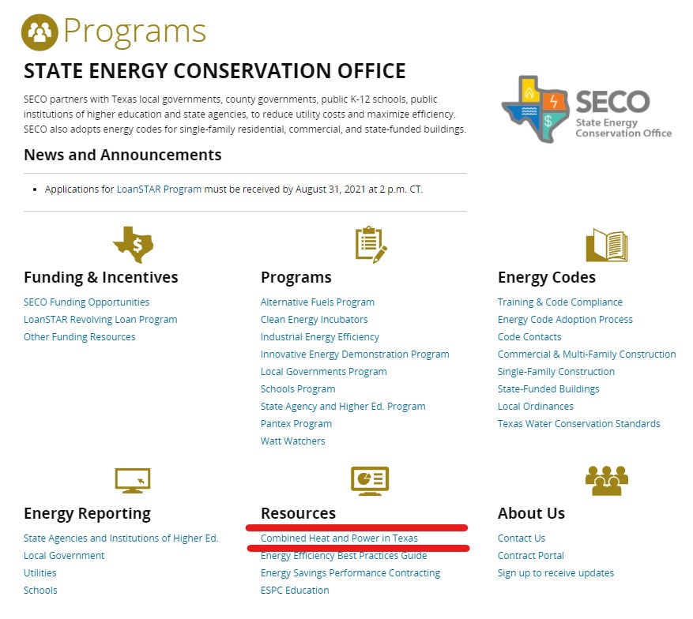

Slide 14
Statute
10 TGC 2311.003
Sec. 2311.002.
COMBINED HEATING AND POWER SYSTEMS.
(a) When constructing or extensively renovating a critical governmental facility or replacing major heating, ventilation, and air-conditioning equipment for a critical governmental facility,
the entity with charge and control of the facility shall evaluate whether equipping the facility with a combined heating and power system would result in expected energy savings that would exceed the expected costs of purchasing, operating, and maintaining the system over a 20-year period.
Notwithstanding Chapter 2302 (Cogeneration), the entity may equip the facility with a combined heating and power system if the expected energy savings exceed the expected costs.
(b) The State Energy Conservation Office shall establish guidelines for the evaluation under Subsection (a).

Slide 15
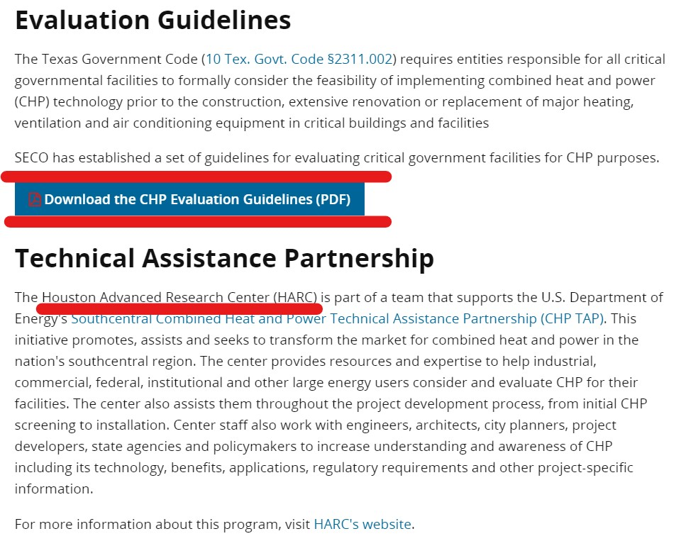
Guidelines

Slide 16

Contacts
Eddy Trevino
Director
512-463-1876
eddy.trevino@cpa.texas.gov
Fred Yebra
SECO Engineer
512-475-0753
fred.yebra@cpa.texas.gov
www.seco.cpa.texas.gov

Slide 17


Q&A Roundtable
Have a question? Please raise your “hand” and unmute your line or place your question in the chat.
Notes:
If you have any questions for any of speakers today, please go ahead and either unmute your line or place them in the chat.

Slide 18
What’s Next?
  Microgrid Tour - 2022
  Develop case studies and best practices
  Develop a selection of achievable energy efficiency options and suggested language for inclusion in HazMAP plans and action tables
Notes:
Here is what to expect next as NCTCOG continues work on this topic.
We will be hosting a microgrid tour in early 2022 to give participants a firsthand look at a microgrid in operation,
Be developing several case studies or best practices for communities interested in the types of projects that we presented on today,
And we will be working on developing a selection of achievable options and suggested language for inclusion in your HazMAP plans and action tables.

Slide 19
Webinar Recording and Presentation Slides
  Today’s presentation slides and recording will be posted on the Conserve North Texas website under News/Events → Event Archive located here: http://conservenorthtexas.org/event-archive
  Follow-up emails to come to all registrants.
  Please email Crysta Guzman, cguzman@nctcog.org, if you did not register but would like to be added to follow-up emails.

Slide 20

FOR MORE INFORMATION
Crysta Guzman
Environment & Development Planner
Environment and Development Department
(817) 695-9107
cguzman@nctcog.org
Lori Clark
Program Manager
Transportation Department
(817) 695-9232
lclark@nctcog.org
https://www.nctcog.org/envir/natural-resources/energy-efficiency

Slide 21


NCTCOG Resources

Slide 22

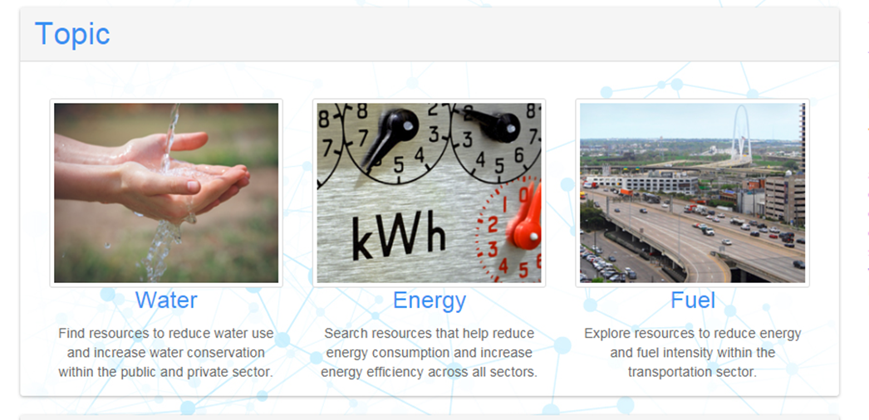
Conserve North Texas
Clearinghouse of Energy Efficiency, Water Conservation, and Transportation Resources
Resource Types:
Programs
Tools
Calculators
Case Studies
www.conservenorthtexas.org

Slide 23

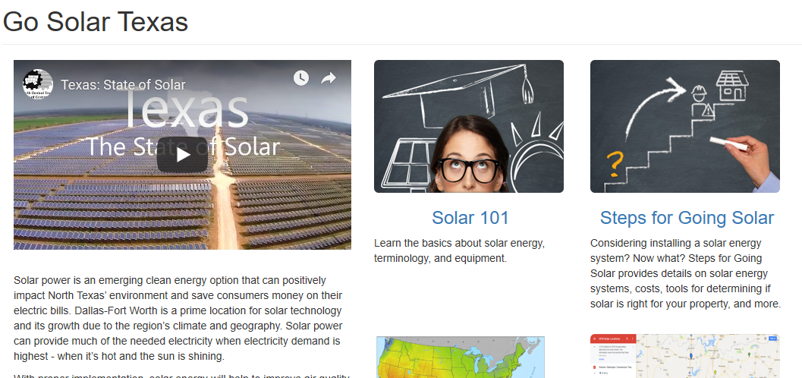
Go Solar Texas
Texas-Specific Information about Solar
Key Resource Types:
Best Management Practices
Cost Benefit Analysis
Trainings
Case Studies
Meeting-in-a-Box
www.gosolartexas.org

Slide 24

SECO Resources

Slide 25
About SECO
Mission Statement: To Increase the Efficient Use of Energy and Water While Protecting the Environment
Focus on Public Sector Facilities – Indirectly Benefitting Taxpayers
Support for Energy and Water Efficiency Project Implementation
  Education and Training
  Technical Assistance
  Project Financing
U.S. Department of Energy State-Level Program Conduit
  State Energy Program (SEP)

Slide 26

SECO Support
Training/Education
  Energy Codes (Workshops & Adoption Toolkit)
Technical Assistance
  Preliminary Energy Audits (K-12 & Local Governments)
  Virtual Energy Audits
Financing
  LoanSTAR Revolving Loan Program
  Energy Savings Performance Contract Guidelines & Education

Slide 27
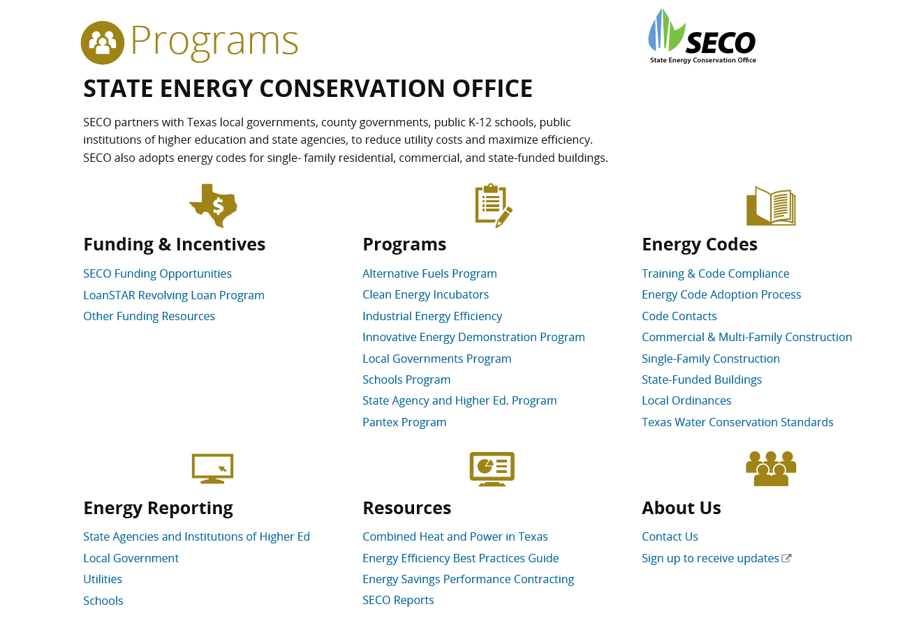


https://comptroller.texas.gov/programs/seco

Slide 28
LoanSTAR Revolving Loan
Finances Projects that Reduce Energy/Water/Utility Costs
  Simple Payback Period of 15 Years or Less
  2% Loan Interest Rate; 1% if Choose ARRA Funds with More Reporting
  Maximum $8 Million Loan Per Application
  Maximum 3 Loans per Entity
Program Page: https://comptroller.texas.gov/programs/seco/funding/loanstar/
Program Overview: https://www.youtube.com/watch?v=4IFuj_5ZeGI

Slide 29

Other Energy Resiliency Planning
Resources

Slide 30
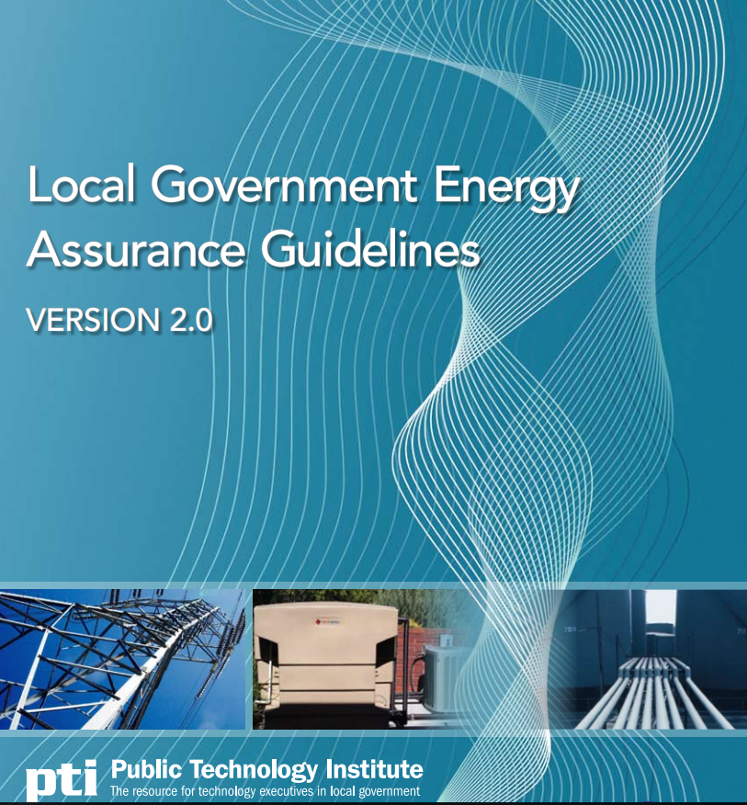
Local Government Energy Assurance Guidelines
Public Technology Institute
The goal is to enable communities to make the transition to a pre-disaster planning and risk reduction approach.
Assist local governments in planning for as well as responding to natural and man-made events and emergencies, often resulting in a decrease or total outage of energy that is needed to sustain critical functions and essential services within a community.
Assist jurisdictions in the recovery phase, in which energy services vital to the health, welfare, and safety of the resident population are restored.
Produced because very few local governments have a response and recovery plan that is specific to energy emergencies.
https://www.naseo.org/Data/Sites/1/documents/energyassurance/documents/pti_local_governement_energy_guidelines.pdf
Local Government Energy Assurance Planning Resources
https://sites.google.com/site/ptileap/publications
http://www.energyassurance.us/

Slide 31
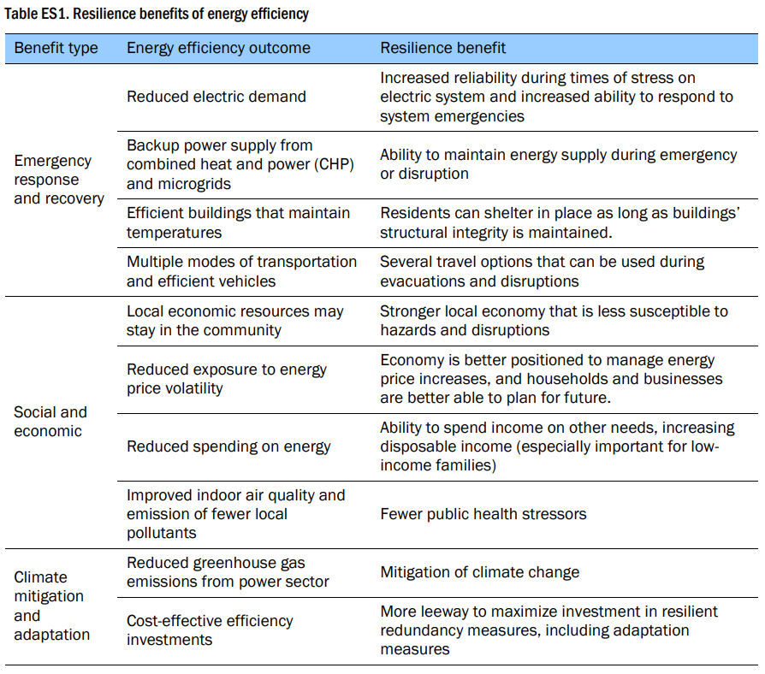
American Council for an Energy-Efficient Economy (ACEEE):
Enhancing Community Resilience through Energy Efficiency
Enhancing Community Resilience through Energy Efficiency : Discusses ways in which energy efficiency can increase the resilience of energy systems and the communities they serve. It reviews the resilience-related benefits of:
  efficiency measures
  incorporation of efficiency into resilience planning
  presents four case studies showing how local governments and utilities can leverage energy efficiency to increase community resiliency
https://aceee.org/sites/default/files/publications/researchreports/u1508.pdf

Slide 32
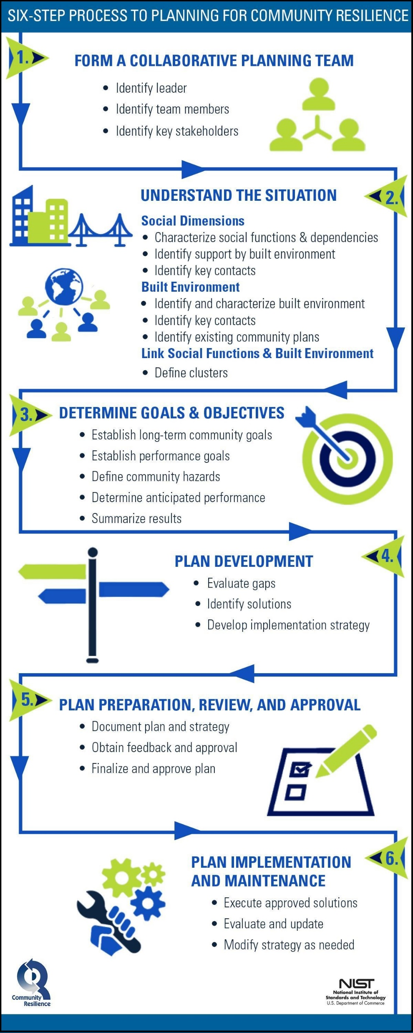
National Institute of Standards and Technology (NIST)
Community Resilience Planning Guide for Buildings and Infrastructure Systems
Helps communities develop consistent resilience goals into their comprehensive, economic development, zoning, mitigation, and other local planning activities that impact buildings, public utilities, and other infrastructure systems
Volume I
Describes the six-step planning process
Volume II
Elaborates on how to characterize the social and economic dimensions of the community, any potential impacts and the infrastructure/building performance.
https://www.nist.gov/topics/community-resilience/planning-guide

Slide 33

The Efficiency-Resilience Nexus
The Better Buildings Efficiency-Resilience Nexus describes energy-efficient technologies and practices that contribute to and increase resiliency.
Department of Energy (DOE)
Better Buildings
Distributed Generation for Resilience Planning Guide
The U.S. Department of Energy Better Buildings Initiative developed the Distributed Generation (DG) for Resilience Planning Guide to provide information on how DG, with a focus on combined heat and power (CHP), can aid communities to meet their resiliency goals. The guide can be used by a variety of users, including decision makers, state and local policy makers and utilities to gain a better understanding on the role that DG and critical infrastructure (CI) in resiliency planning.

Slide 34
Department of Energy (DOE)
Southcentral Technical Assistance Program with HARC
Promotes Combined Heat and Power (CHP) technology solutions for the industrial and manufacturing sector, critical infrastructure, institutions, commercial facilities, and utilities seeking to reap the many benefits of CHP.
CHP is increasingly recognized as a way to make facilities more resilient against power outages.
Houston Advanced Research Center (HARC) in The Woodlands, Texas has been awarded funding from the U.S. Department of Energy (DOE) to assist public and private entities considering CHP.
More information or to fill out interest survey:
https://www.harcresearch.org/work/CHP_TAP

Slide 35
Financial Tools & Resources
Better Buildings Financing Navigator
This navigator helps you Avoid the complexity associated with securing appropriate financing for your energy efficiency projects
Commercial property assessed clean energy (CPACE) Financing for Resiliency Toolkit
LEARN ABOUT AVAILABLE FINANCING THAT CAN BE USED TO FUND RESILIENCY IMPROVEMENTS TO MAKE BUILDINGS MORE RESISTANT TO NATURAL DISASTERS OR THREATS

Slide 36

Additional Resources
Department of Energy (DOE) State and Local Solution Center
Explore resources related to energy planning, financing energy initiatives, accessing energy data and designing energy programs.
National Renewable Energy Laboratory’s REopt Lite Tool
This free tool evaluates the viability of on-site grid-connected photovoltaic, wind, and battery storage, potential battery dispatch and size, and the critical load a system can sustain during a grid outage.

Slide 37
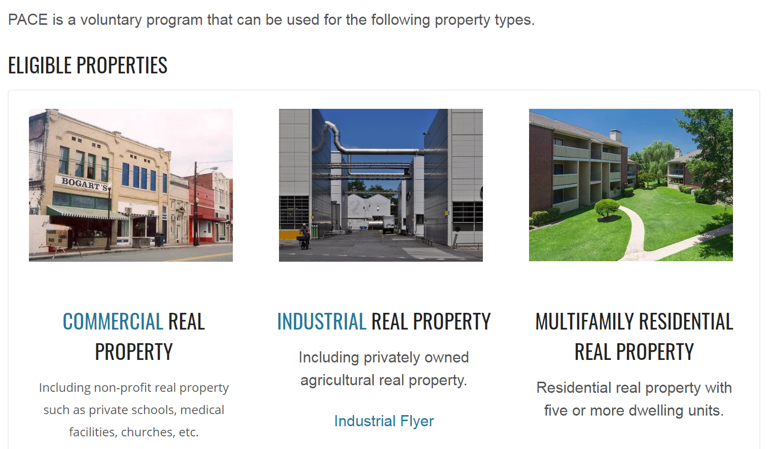
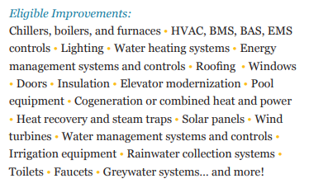
Texas Property Assessed Clean Energy (TX-PACE) Program
As of August 2021, PACE in North Texas Programs:
Corinth
Dallas
Farmers Branch
Princeton
Prosper
Erath County
Navarro County
Tarrant County
TX-PACE facilitates the use of private capital to finance water conservation, energy efficiency, resiliency, and distributed generation projects to eligible properties
Source: https://www.texaspaceauthority.org/wp-content/uploads/public-sector-2018-11-19.pdf
www.TexasPACEAuthority.org

