Slide 1

Local Government Energy Reporting Workshop
North Central Texas Council of Governments
January 10, 2024

Slide 2
Welcome & Housekeeping
Please sign in using the sign-in sheet at the front. Separately, we will send around a form attesting whether your time can be used for in-kind match.
The workshop slides and audio recording will be posted on the Conserve North Texas website under News/Events → Event Archive at the link below. Follow-up emails to come. http://conservenorthtexas.org/event-archive
Additional information and resources are included in the printed materials on the table by the door. Please take a copy!

Slide 3

Agenda
  12:00 PM – 12:15 PM Welcome and Housekeeping Items
  12:15 PM – 1:00 PM Lunch and Networking
  1:00 PM – 1:30 PM NCTCOG Programs and Events
  Joaquin Escalante – Planner, NCTCOG
  SECO Overview
  Adam Mueller – Program Specialist, SECO
  1:30 PM – 2:25 PM Annual Local Government Energy Reporting
  Shaun Marie Auckland – M.S.I.S., LEED Green Associate,
                Local Government Program Manager, SPEER
  2:25 PM – 2:30 PM Closing Remarks
  Joaquin Escalante – Planner, NCTCOG
Notes:
Announce Q&A to after Shaun's presentation

Slide 4



Who We Are
How do we support energy management efforts for entities across the state?
NCTCOG is a regional planning agency serving North Texas local governments on a variety of topics. NCTCOG’s Regional Energy Manager project is an ongoing effort to identify energy management needs, increase awareness to the local government energy reporting requirements, and provide resources to assist local governments in energy conservation efforts.
SECO partners with local governments, public K-12 schools, public institutions of higher education and state agencies, across Texas to reduce utility costs and maximize energy efficiencies.
SPEER’s Local Governments Program support city energy management by facilitating sharing of best practices in energy efficiency, while strengthening relationships among local governments through the City Efficiency Leadership Council (CELC).

Slide 5

SolSmart
SolSmart is a national designation and technical assistance program that helps local governments make it faster, easier, and more affordable for residents and businesses to go solar
Increase transparency​
Post a solar permitting checklist online​
Develop a solar landing page​
Increase understanding​
Train staff on solar best practices ​
Support a solar information session or solar tour​
Reduce barriers​
Decrease permit turnaround time ​
Codify explicit regulations for the different forms and uses of solar PV
Streamline processes
+
Clear solar guidelines
Better submittals to local government departments
+
Solar training for staff
Shorter processing times
Time savings for department staff
+
Budget savings for local governments
For more information, visit GoSolarTexas webpage.

Slide 6



Dallas-Fort Worth Clean Cities
Annual Fleet Report and Survey
The Department of Energy’s Annual Fleet Survey tracks the progress of DFWCC’s goal to increase petroleum and greenhouse gas reductions, with fleets participating in the survey eligible for various recognition awards.
Award levels range from Bronze to Gold, and special awards for significant progress and meeting self-imposed goals. The 2023 Annual Survey will be available online January 2024.
Annual Survey
Fleet Recognition Awards
DOE Annual Fleet Report

Slide 7
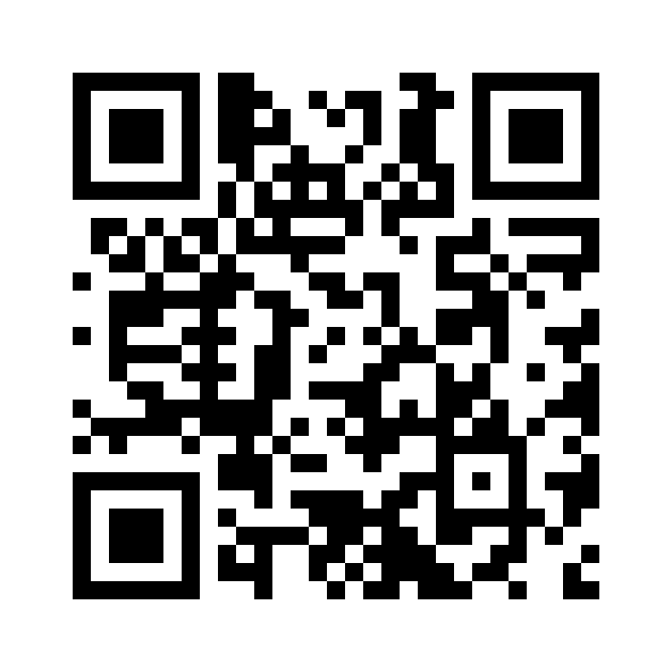
Dallas-Fort Worth
Air Quality Improvement Plan (AQIP)
Regional plan to improve air quality in North Texas
Funded by the Environmental Protection Agency’s (EPA) Climate Pollution Reduction Grants (CPRG)
Seeking feedback on measures which:
Can be implemented in 2025
Benefit disadvantaged communities
Are cost-effective
Provide greenhouse gas and criteria pollutant reduction
Go to www.publicinput.com/DFWAQIP for more information, attend a meeting, or respond to a survey.

Slide 8
Upcoming Workshops and Webinars
Operational Maintenance Protocols & Policies
Webinar
TDB, March 2024
Influencing Leadership on Sustainability
Workshop
TBD, late April/early May
Creating a Water Conservation Policy
Webinar
June 22, 2024
More information to come via newsletters and updates to the Conserve North Texas website conservenorthtexas.org

Slide 9
Stay Informed on Upcoming Events
Upcoming NCTCOG Events
Environment & Development: https://nctcog.org/envir/events
DFW Clean Cities: www.dfwcleancities.org/events
NCTCOG’s Free E-Mail Lists and Committee Updates
General Updates​
Environment & Development
Transportation

Slide 10
NCTCOG Resources
Conserve North Texas (https://www.conservenorthtexas.org/)
Recently Added Resources:
Climate Mapping for Resilience and Adaptation Portal
Go Solar Texas (https://www.gosolartexas.org/)
Energy Management, Efficiency, and Renewable Energy
(https://www.nctcog.org/envir/natural-resources/energy-efficiency)
Fall 2023 Energy Funding Newsletter
Notes:
When covering the energy funding newsletter cover this, mention that the next email will be going out this month in January.

Slide 11

Workshop Sponsor
NCTCOG receives funding through SECO to work on energy management and efficiency projects within the region. As part of this work, we have provided webinars and technical assistance on a variety of energy management, energy efficiency, and renewable energy topics.
www.nctcog.org/envir/natural-resources/energy-efficiency
https://www.conservenorthtexas.org/

Slide 12




SECO Resources
No-cost resources offered by SECO to aid entities in achieving their energy management or efficiency goals
LoanSTAR
  2.5% (1.5% for ARRA funds)
  Simple payback of 15 years or less
  Applications are now open
WattWatchers of Texas
  Behavioral program for schools and families
  TEKS aligned STEM material
Technical Assistance
  Preliminary Energy Assessment (PEAs)
  Analysis of current systems, O&M programs
  Energy Management Policy development
  Funding options
  Prioritized project planning
Local Government Energy Reporting
  Technical assistance for State-mandated energy efficiency and reporting

Slide 13
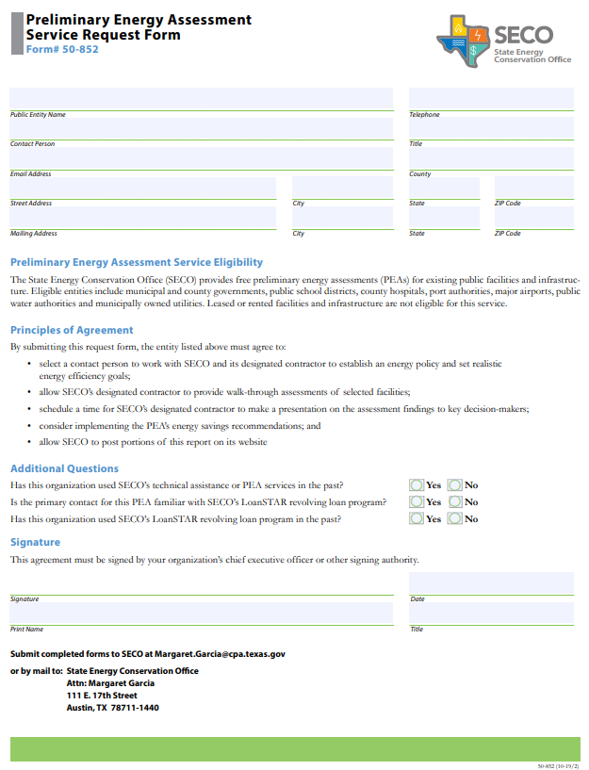

Preliminary Energy Assessments (PEAs)
Preliminary Energy Assessments (PEAs) are provided by the State Energy Conservation Office (SECO) and offer cost effective resource efficiency measures entities can implement to decrease energy consumption at no cost to you!
Help guide the development of an energy management policy
Provides facility benchmarking using ENERGY STAR Portfolio Manager
Recommended maintenance procedures
Develop efficiency level guidelines for equipment purchases

Slide 14
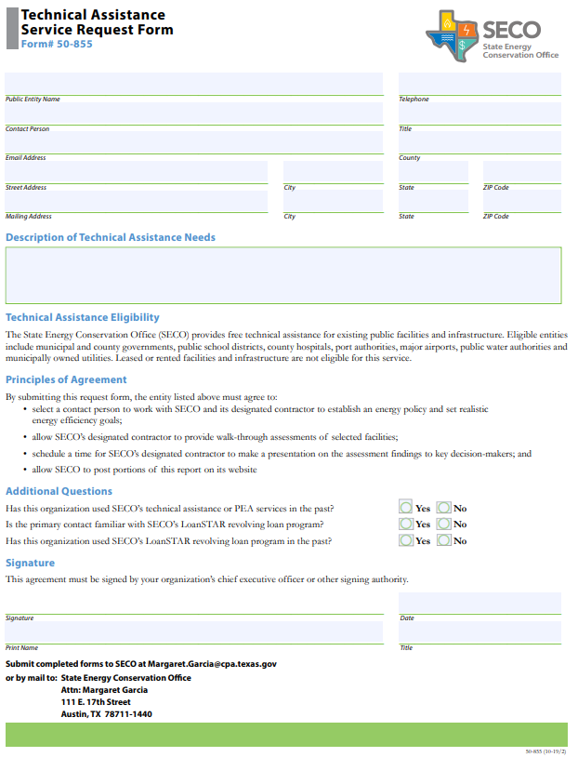

SECO No-Cost Technical Assistance
Through this program SECO contracts with engineering firms to provide customized, on-site, energy-related services ranging from basic consultation to feasibility studies.
Eligible entities may request assistance with either energy or water-related technical matters.
Upon determination that the requested services are reasonable and within the contractors' scope of work, SECO will assign an engineer to contact the entity officials to determine the level of service necessary to provide assistance.
For more information, visit SECO’s Technical Assistance webpage.

Slide 15

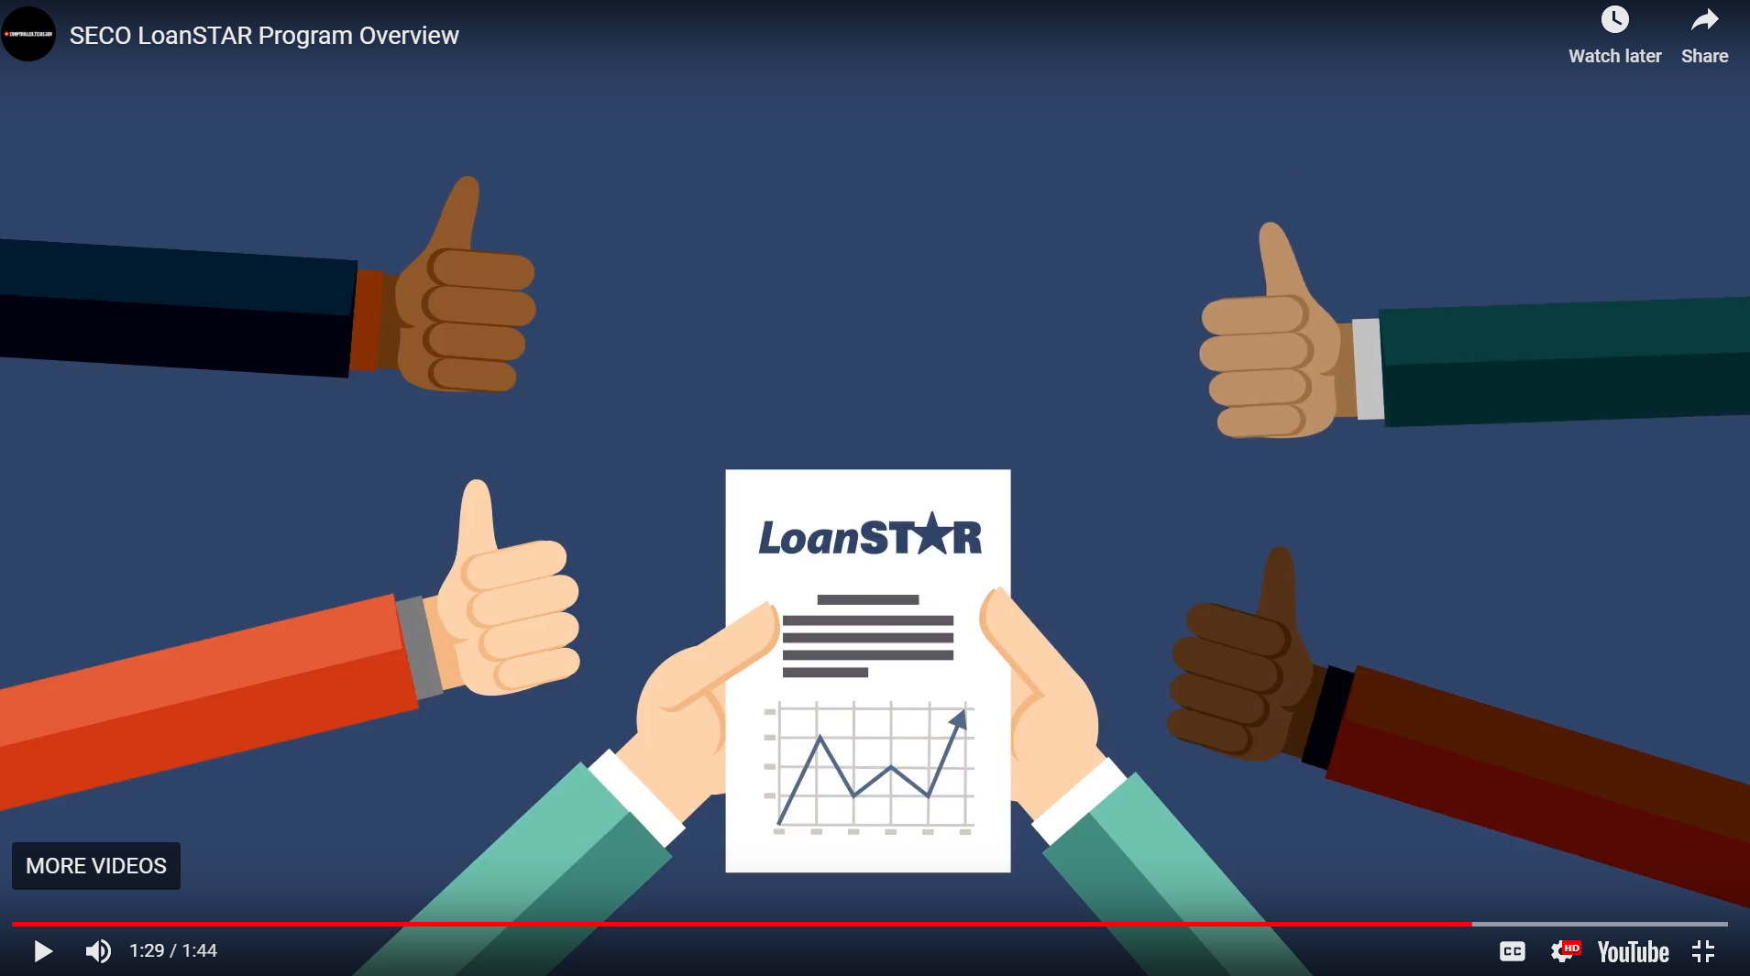
Texas LoanSTAR Revolving Loan
Finances Projects that Reduce Energy/Water/Utility Costs
  Simple Payback Period of 15 Years or Less
  2.5% Loan Interest Rate; 1.5% if you choose ARRA Funds with more reporting requirements
Open Enrollment Through August 30, 2024
  Maximum $6 Million Loan Per Application
  Maximum 1 Loan per Applicant
For more information visit the
Notice of Loan Fund Availability
https://www.youtube.com/watch?v=4IFuj_5ZeGI
Source: https://comptroller.texas.gov/programs/seco/funding/loanstar/
Notes:
Presenter: Dorothy

Slide 16
Annual Local Government Energy Reporting
Shaun Auckland - M.S.I.S., LEED Green Associate,
Local Government Program Manager, SPEER

Slide 17
Reporting Made Easy: Essential Resources for Submitting a Report
Reporting Template for collecting data and submitting the report- download at this link
SPEER has developed a Frequently Asked Questions guide for download and a website to support political subdivisions with their 2021 reporting, and we are available to answer questions or provide technical support to any reporting entities
State Energy Conservation Office’s energy dashboard

Slide 18
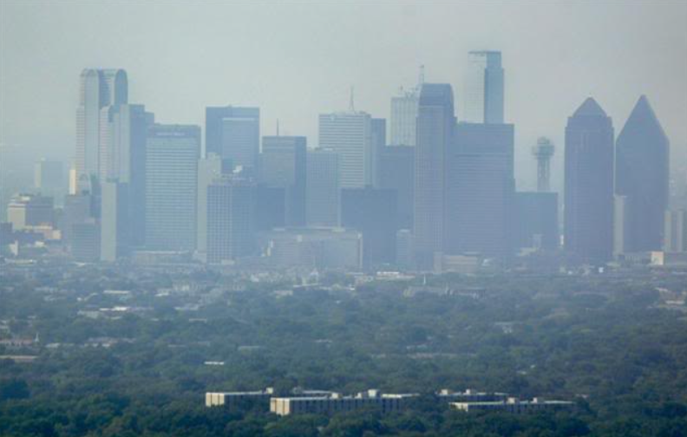
Why Does Local Government Energy Reporting Exist?
17
Notes:
Presenter: Dorothy
Audience – is for local govt’s & state agencies
What does ozone pollution look like and nonattainment areas in the state
Ozone season

Slide 19
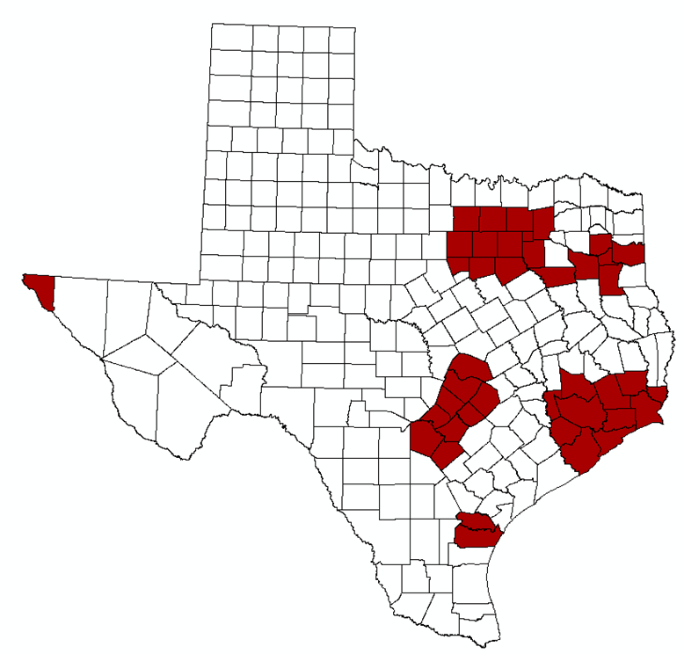
Local Government Energy Reporting
Section 388.005 Texas Health and Safety Code:
Purpose: Aid efforts to attain federal air quality standards by reducing demand for electricity generation
Who Reports: Political subdivisions, institutes of higher education or state agencies in 41 “affected counties” in Texas.* Political subdivisions include cities, counties, water districts, and other local government entities.
Requirements: Establish a goal of reducing electric consumption by at least 5% each state fiscal year for 7 years beginning September 1, 2019, and submit an annual report to SECO regarding the progress and efforts to meet the reduction goal
70% of TX Population
*Bastrop, Bexar, Brazoria, Caldwell, Chambers, Collin, Comal, Dallas, Denton, El Paso, Ellis, Fort Bend, Galveston, Gregg, Guadalupe, Hardin, Harris, Harrison, Hays, Henderson, Hood, Hunt, Jefferson, Johnson, Kaufman, Liberty, Montgomery, Nueces, Orange, Parker, Rockwall, Rusk, San Patricio, Smith, Tarrant, Travis, Upshur, Waller, Williamson, Wilson, and Wise (Texas Administrative Code, Title 30, §114.629)
Notes:
Presenter: Fred
70% of population is concentrated in these counties
Why is it these counties bc its greatest concentration of emissions and population
Health and safety code includes energy reporting and energy codes

Slide 20
History and Background
2001
This requirement, introduced in the 77th Legislative Session by Senate Bill 5 (SB5), was established to reduce air emissions associated with electricity consumption in ozone nonattainment or near nonattainment counties
2007
The 80th Legislature passed SB12, extended for entities to establish a goal to reduce electric consumption by 5% out to 2011
2011
In the 82nd Legislature, the passage of SB898 signified the continuance of establishing an energy reduction goal out to 2021. Allowed for exemption certification requests
2019
SB241 passed in the 86th Legislature set 2019 as the baseline year for establishing a 5% reduction goal and extended the timeline for local governments to establish a goal to reduce electric consumption out to 2026
For full history, visit SECO’s “History of Legislation for Public Sector Energy Reporting” webpage.
Notes:
Presenter: Fred

Slide 21
Impacts for State Air Quality
Local Government Energy Reporting Forms Submitted to SECO
Data Processed and Reported to the Texas A&M Energy Systems Laboratory (ESL)
ESL Estimates Total NO_{X} Reductions and Submits to Texas Commission on Environmental Quality (TCEQ)
TCEQ Includes in the Texas Emissions Reduction Plan (TERP) Biennial Report to the Texas Legislature
1.58
Tons per day NO_{X} Reduced in 2019
Source: ESL, “Energy Efficiency and Renewable Energy Impacts on NOx Emission Reductions in Texas”
Notes:
Presenter: Dorothy
1.58 tons per day of NOx reduced statewide

Slide 22



Impacts for Local Governments
Effectively Manage Energy Consumption Informed by Data Collection
Ability to Measure Performance Among Peer Entities Using SECO’s “Energy Consumption Reporting Dashboard”
Identify Opportunities for Energy Efficiency Projects
Pursue No-Cost Technical Assistance and Resources Through SECO to Accomplish Energy Efficiency Projects
Notes:
Presenter: Dorothy

Slide 23
Effectively Manage Energy Consumption Informed by Data Collection
Ability to Measure Performance Among Peer Entities Using SECO’s “Energy Consumption Reporting Dashboard”
Identify Opportunities for Energy Efficiency Projects
Pursue No-Cost Technical Assistance and Resources Through SECO to Accomplish Energy Efficiency Projects
Impacts for Local Governments
Notes:
Presenter: Dorothy

Slide 24

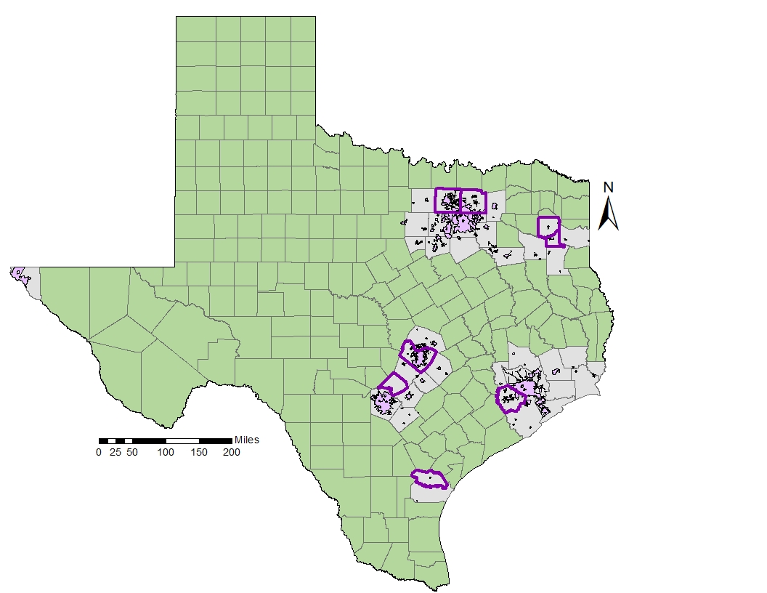
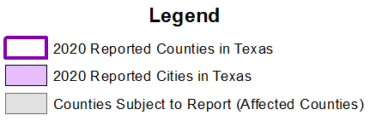
2022 Local Government Energy Reporting Participation
*Institutes of Higher Education, Special Districts, Appraisal Districts, and State Agencies who reported are not shown
Number of Cities
Who Reported: 142
Number of Counties Who Reported: 48
Notes:
Presenter: SPEER
This map provides a broader view of the entities within the:
41 non-attainment areas or affected counties in Texas: Bastrop, Bexar, Brazoria, Caldwell, Chambers, Collin, Comal, Dallas, Denton, El Paso, Ellis, Fort Bend, Galveston, Gregg, Guadalupe, Hardin, Harris, Harrison, Hays, Henderson, Hood, Hunt, Jefferson, Johnson, Kaufman, Liberty, Montgomery, Nueces, Orange, Parker, Rockwall, Rusk, San Patricio, Smith, Tarrant, Travis, Upshur, Waller, Williamson, Wilson and Wise.
The regions with entities subject to report are gray with the cities and counties who have reported within that region are purple with the participating counties outlined in purple.
Moving forward SPEER will continue to partner with COGs to provide the reporting workshops at least twice a year as a resource for entities. Please share with your local government collegues the need to report and resources.

Slide 25
Local Government Energy Reporting Statistics
Number of Texas Entities
Who Submitted a Local Government Energy Report
Composition of Texas Entities Who Submitted a 2022 Local Government Energy Report
NCTCOG & SPEER Began Outreach and Technical Assistance
Source: State Energy Conservation Office (SECO), 2023
Notes:
Presenter: SPEER
As you can see once the State Energy Conservation Office pivoted to a online platform for reporting and increase in outreach local government reporting became more accessible. There are several opportunities for improvement with the various entities.

Slide 26
Local Government Reporting Form (Online)
Report Sections
Reporting Entity Information
Reduction Goal
Calendar Year of Report
Consumption Data
Renewable Energy Data (Optional)
Use and Interest in SECO Assistance Resources
Areas of Improvement & Resources
Additional Feedback
Progress Toward Goal
Sections 1, 2, 3, 6, 7, 9 and portions of Section 4 of the Local Government/State Agency Energy Report must be completed by all reporting entities. Section 5: Renewable Energy Data is optional.

Slide 27
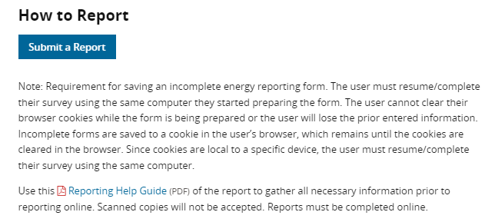
Getting Started
Create a Data Checklist (see reporting help guide)
Know your data sources
Keep your data organized, consistent and “tidy”
Prep for next year now!
Reporting Link
Notes:
Presenter: JT

Slide 28
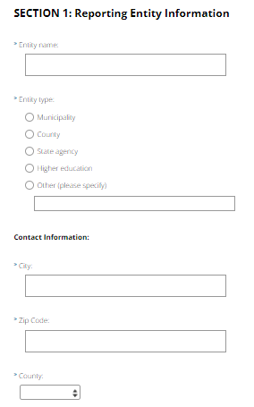
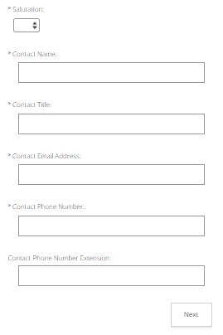
Section 1: Background Information
City Information
Contact Information
Ensure to update contact information for those who will be completing next years reporting

Slide 29
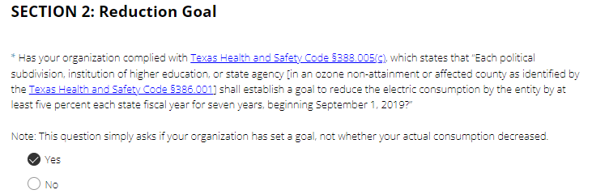
Section 2: Reduction Goal
Reduction goal established (Y/N)
Goal can take several forms
Denton historically does this through council resolution
Updates with each new iteration of the SB to reflect length of time and start date

Slide 30
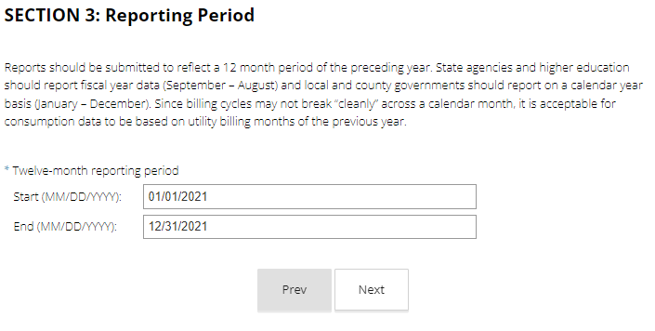
Section 3: Reporting Period
Reporting period for local governments Jan 1 to Dec 31
As stated, your January data or December data may overlap into other months
Current Practice: split months based on meter read date (before or after the 15th of the month)

Slide 31
Section 4: Consumption Data
Checklist helps in this section
Know your data sources
Organization starts with data collection create a SB 241 field if possible (BF, ST, TS, W, WW, NA)
Get informed on account changes

Slide 32
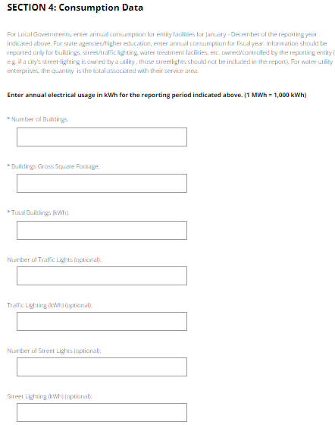
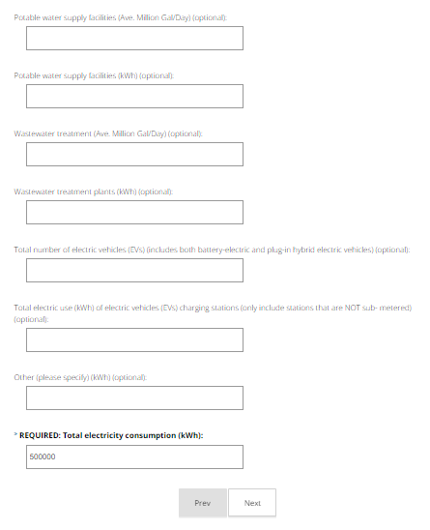
Section 4: Consumption Data
Buildings
  Risk management is a great resource
  Keep billing codes in mind
Lighting
  Metered vs. unmetered
  Owned vs. unowned
Water and Wastewater
  You may or may not have a treatment plant to report
  You will have pumps and lift stations

Slide 33
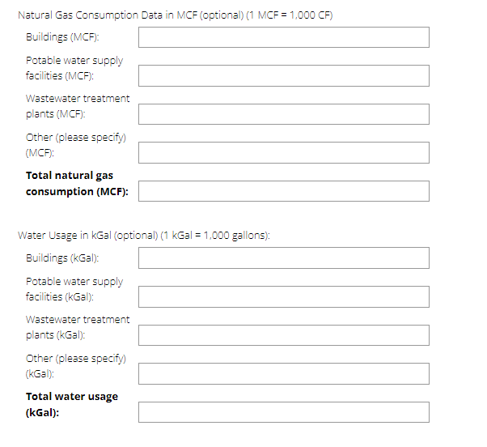
Section 4: Consumption Data
Natural Gas
  Check your units
  Different data set than electricity
  Data storage tip – have at least one linking data field (ex. address)
Water Usage
  Billing category vs. usage category

Slide 34
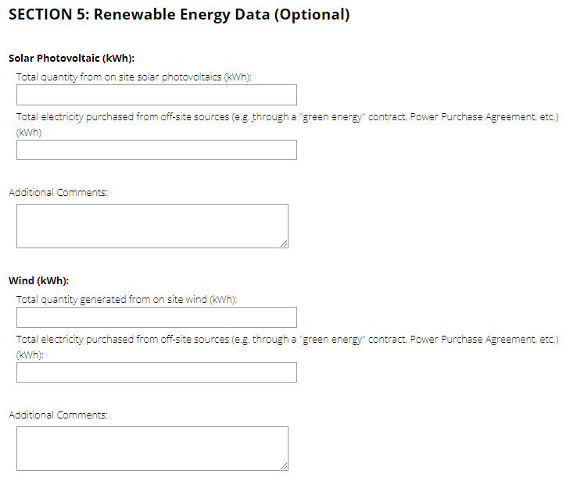
Section 5: Renewable Energy Data
Solar, Wind, Biomass, Geothermal
On site summary
  Entity energy footprint
PPA Summary

Slide 35
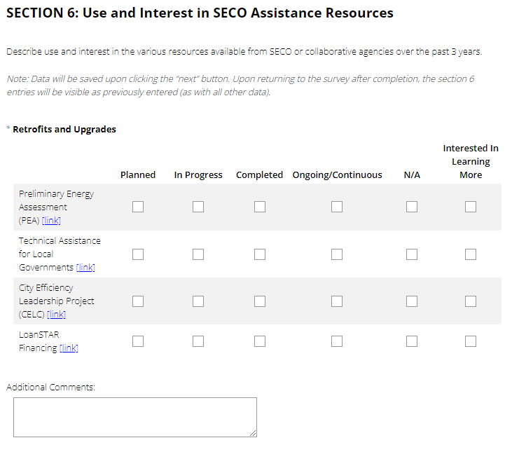
Section 6: SECO Resources
Preliminary Energy Assessment
Technical Assistance
LoanSTAR financing

Slide 36
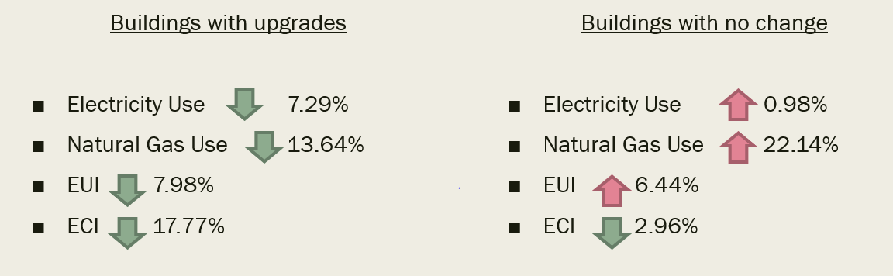
Section 7&8: Areas of Improvement and Progress
Physical upgrades
  HVAC
  Insulation
  Management systems
Policies and Training
  Internal Energy Policy
Trainings (Denton has incorporated into monthly safety training in the past)
City of Denton Example: upgrades following Denton’s PEA

Slide 37
Section 9: Exemption Request
Did you reach your goal?
  Calculate based on 2019 baseline totals
Claim exemptions if applicable after report has been completed

Slide 38
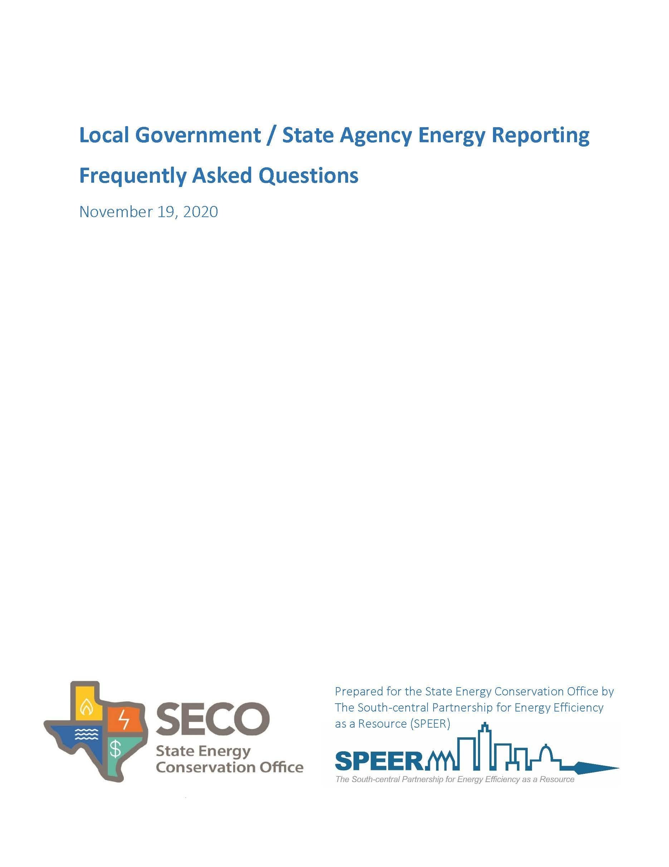
Local Government Energy Reporting
Frequently Asked Questions
Developed by SPEER using feedback and interviews with reporting entities
Covers general questions and section-by-section guidance
Download Here!
Notes:
Presenter: Shaun

Slide 39



NCTCOG Local Government Energy Reporting
Resources
Whitepaper
Texas’ Mandated Local Government Energy Reduction Goal - Challenges and Best Practices
Case Study
Development of an Energy Management Plan for Tarrant Regional Water District
Case Study
The City of Lewisville's Energy Consumption Reduction
All Resources can be Accessed via
www.conservenorthtexas.org
Local Government Energy Reporting Toolkit
Notes:
Presenter: Dorothy

Slide 40


Key Takeaways and Next Steps
March
4
Local Government Energy Reporting Deadline
Calendar Year Reporting Period: January 1 – December 31
Minimum Required Data Points Include
  Reporting Timeframe (e.g., Calendar Year)
  Annual Electricity Consumption in Kilowatt Hours (kWh)
  Gross Square Footage of All Entity Owned Buildings/Facilities
Review Prior Reporting Data on SECO’s “Energy Consumption Reporting Dashboard”
Notes:
Presenter: Dorothy

Slide 41
SECO and SPEER Contacts
Shaun Auckland
Program Manager
The South-central Partnership for Energy Efficiency as a Resource (SPEER)
cities@eepartnership.org
Adam Mueller
Program Specialist
State Energy Conservation Office (SECO)
Adam.mueller@cpa.Texas.gov

Slide 42
NCTCOG Contacts
Joaquin Escalante
Planner
Transportation
817-704-5646
Jescalante@nctcog.org
Amy Hodges
Principal Air Quality Planner
Transportation
817-704-2508
amyhodges@nctcog.org
Crysta Guzman
Senior Planner
Environment & Development
817-695-9107
cguzman@nctcog.org
Alyssa Knox
E&D Planner II
Environment & Development
817-695-9221
aknox@nctcog.org
energy@nctcog.org

Slide 43
Reminder!
Please complete the Workshop Evaluation
Please complete the In-Kind Attestation Form

